Slide 1
Digital Identity with Voice and Facial Authentication using blockchain datastructure
InterruptZero (#317)

Slide 2


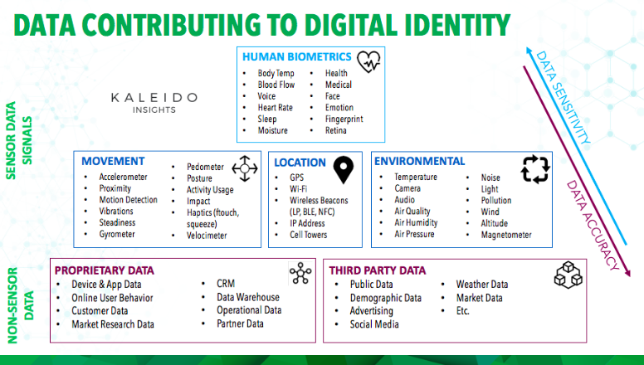
1. Intro
Our model leverages ,Blockchain technology which is a decentralised storage network, where each data of each user/ customer is stored in blocks within their host systems, but the difference here is that, each block is connected with each other over the decentralized network using the hash values .
Highlights
No central data silo.
Highly Secure(AES)
Power of blockchain

Slide 3
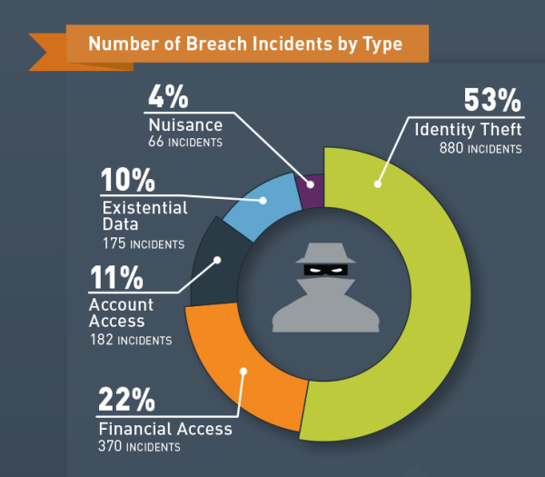
How many data/identity thefts will it take to adopt blockchain in the
industry?
Did you know?
https://blog.gemalto.com/wp-content/uploads/2016/03/number-of-breach-incidents-by-type.png

Slide 4
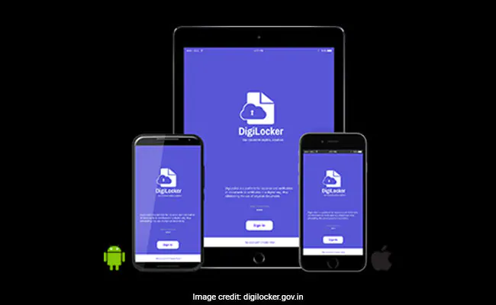
2. Current Solution
Digilocker Uses cloud based storage, for storing vital documents which has a single point of vulnerability .

Slide 5
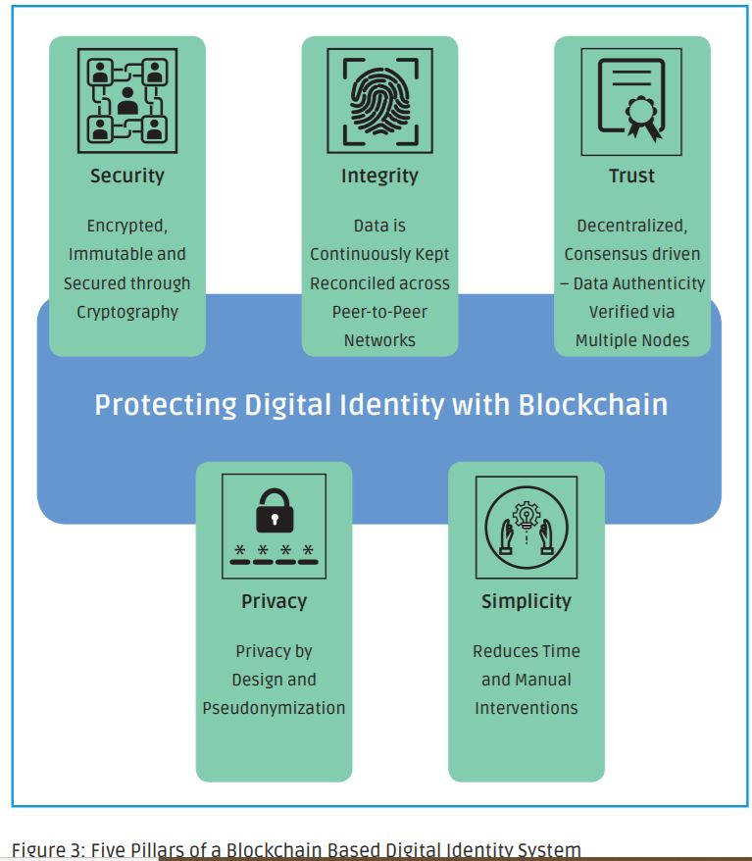
Vyaktitva,Your own.
- Vyaktitva stores digital identity on a hybrid blockchain. Hybrid because files are not stored on blockchain, but access information is stored on the blockchain.
-Since it is a decentralised storage, it eliminates the single central breach of data.
- Also the files stored on the client machine/phone is encrypted with AES encryption.

Slide 6
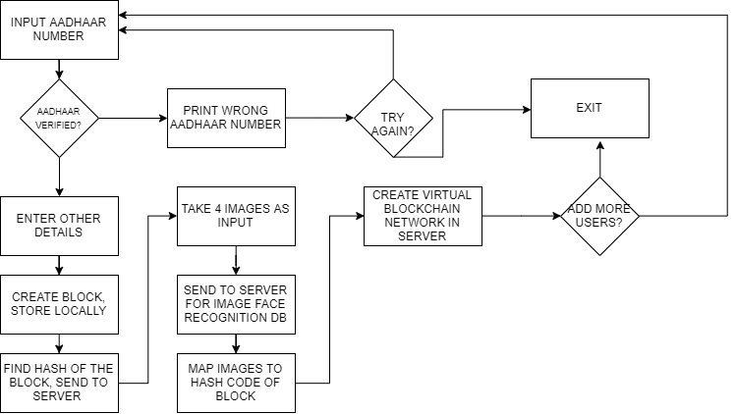
YES
NO
NO
NO
YES
YES

Slide 7
CLIENT APP
NETWORK SERVER
INPUT IMAGE SENT TO NETWORK SERVER
INPUT IMAGE
FACIAL RECOGNITION
MAPPED CORRESPONDING BLOCK PASSKEY
BLOCK DATA HOLDING THE INFO
PASSKEY SENT BACK FOR USER TO ACCESS THE BLOCK

Slide 8
CLIENT 1
CLIENT 2
HASH CODE LINK
BLOCK 2
BLOCK 1
NETWORK MANAGER
FACIAL RECOGNITION SOFTWARE
FACES DATABASE
SENDING OF FACE IMAGES
HASH CODE LINK
SENDING OF FACE IMAGES
SENDING OF PASSKEYS BACK TO CLIENTS
MAPPING TO PASSKEYS
BLOCK 3
BLOCK 4
HASH CODE LINK
CLIENT 4
CLIENT 3

Slide 9

Technology Stack/ Models
Hidden Markov Model (Voice authentication)
GMM, MFCC coefficients
OpenCV (Face recognition)
Socket programming
Peer to Peer N/W, Decentralisation
Blockchain DS, SHA256 Hashes
AES encryption of JSON data
Django (Web Frontend)
Kivy/Flutter (App Frontend) [if time permits]
Did you know?
Google Voice Assistant (OK Google) uses HMM to train a person’s voice footprint.
HMM works brilliantly for less train data. Therefore as few as 3 voice samples are enough to train the model.

Slide 10
4. Conclusion
Profitable aspects
Subscription based with a free trial,
for users to experience the ease of sharing of identity in trusted locations..
Scalable NoSQL databases can be leveraged to store access data, for quicker search times.
Time to market? Immediate priorities-
-Building a user friendly mobile app.
-Using PayAsYouGo cloud blockchain.

Slide 11
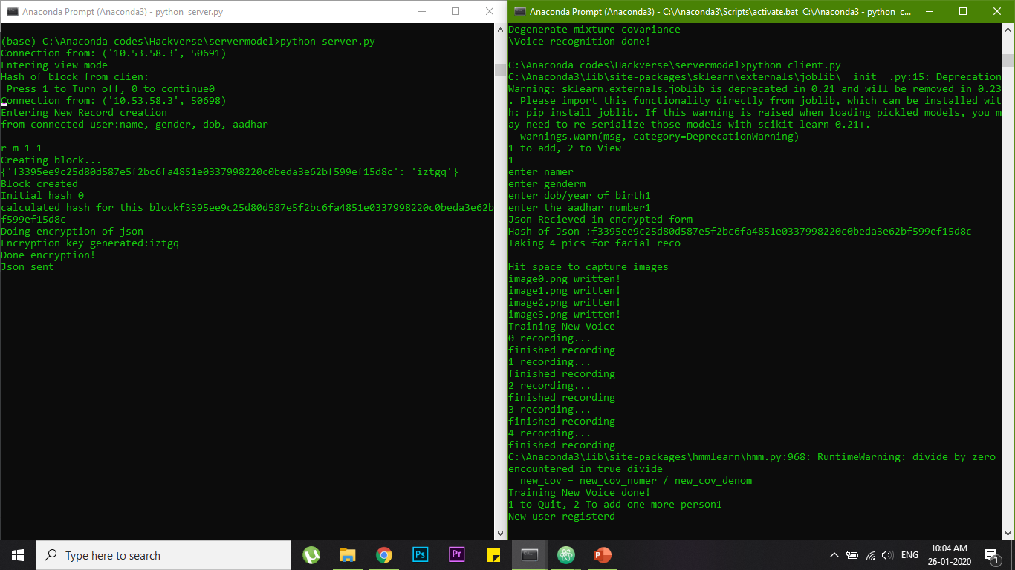
Some screenshots
-new user registration
-Face recognition
- voice training

Slide 12
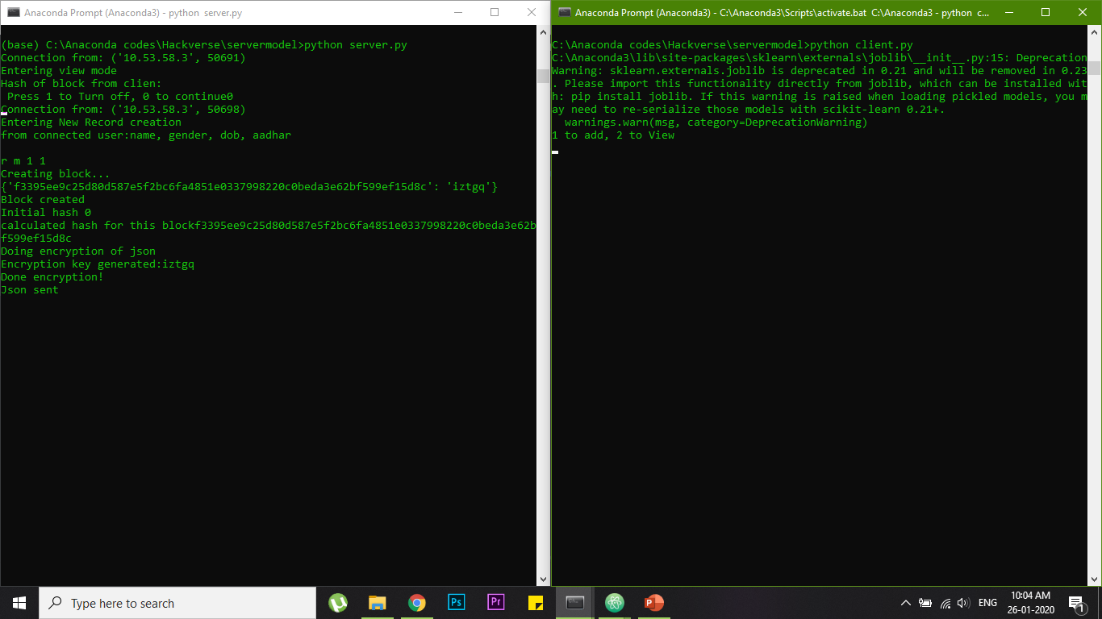
Some screenshots
-BLock creation
-AES Encryption of
Json data.

Slide 13
Phase 2 - Expected
Implement the backend on a user friendly frontend
(USING KIVY-python )
improve accuracy of face and Voice authentication
(making changes to thresholds and MFCC coefficients)
remove socket programming deadlocks
QR CODE generation to share data with other users.

Slide 14
Thank you
We are team
InterruptZero
#317

